Slide 1
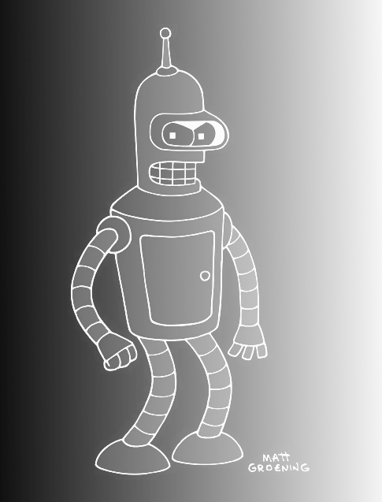


How Machine Learning can be used to solve plant biology problems
Shin-Han Shiu & Serena Lotreck
Michigan State University
#PlantBio20
Notes:
Image credit:
https://www.pinterest.com/pin/292945150756287202/
https://www.pinterest.com/pin/549509592004746347/

Slide 2

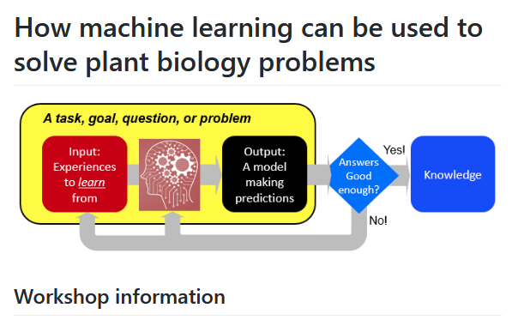
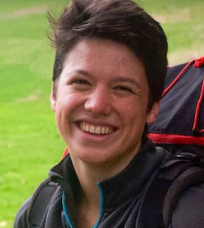
Logistics
Now, use the chat box to say hi to everyone by letting them know which institution you are from!
We will ask for your feedback with poll a few times
Time permitting, we will have a short discussion conducted in the breakout rooms.
Use the chat function to ask questions
Code of conduct - behaviors that will not be tolerated:
Discrimination
Sexual harassment
Bullying
Speech that is personally offensive
Deliberate intimidation, sustained disruption
Other types of harassment
https://github.com/ShiuLab/ML_workshop
https://plantbiology.aspb.org/code-of-conduct/

Slide 3
Goals of this workshop
At the end of this, you should be able to:
Define ML and basic ML terminology
Identify what kinds of problems that can be solved with ML
Describe how a model can be evaluated with a performance measure
Explain to others what the major limitations of ML are

Slide 4
Workshop schedule (this is optimistic…)
Components | Duration | Details
Introduction | 10 min | What is machine learning (ML) and why?
Discussion 1 | 5 min | Questions about the introduction.
Running ML analysis | 30 min | [Eyes-on] How to run an ML analysis?
Discussion 2 | 10 min | What have you learned and what’s challenging?
Summary | 5 min | What’s the limitation and how about some resources?

Slide 5
WHAT
IS MACHINE LEARNING AND
WHY?

Slide 6

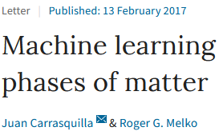
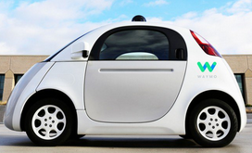
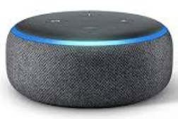
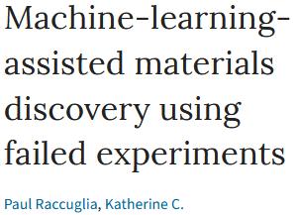
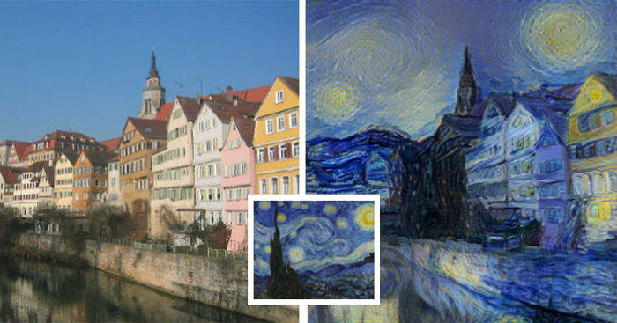
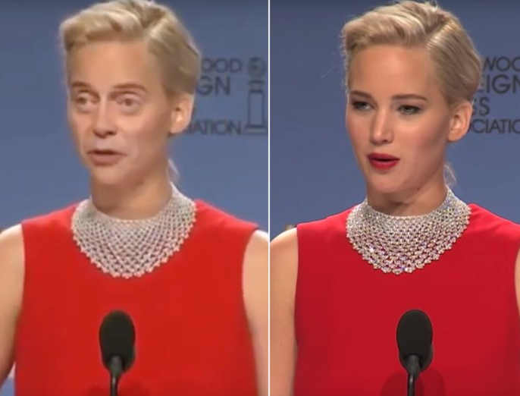
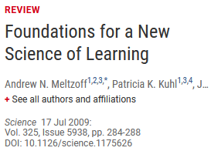

Why ML
ML publications in PubMed as of 7/22/20
As a person
As a scientist
As a biologist
As a plant biologist
Machine learning
Others
(15,626)
Human
(18,668)
Plant (1,027)
Image credits: in notes
Notes:
Image credits:
https://cdn.technologyreview.com/i/images/waymovehicle1.jpg?sw=959&cx=0&cy=466&cw=3000&ch=1687
https://compostables.org/wp-content/uploads/2018/09/All-new-Echo-Dot-3rd-Gen-Smart-speaker-with-Alexa-Sandstone-0.jpg
https://amp.businessinsider.com/images/5c6d85ca2628986f7f3a5d02-750-563.jpg
https://static.boredpanda.com/blog/wp-content/uploads/2015/08/computer-deep-learning-algorithm-painting-masters-fb__700.jpg
https://media.salon.com/2019/01/facial-recognition2.jpg
https://www.greenmangaming.com/newsroom/wp-content/uploads/2019/07/GooglrDeepMind.jpg

Slide 7

Why ML
Address questions
previously not
answerable or
conceived
Growing data: What can we learn and how?
Molecular data
Evolutionary/
ecological data
Assess quantitatively
how much we know
Genomes
Metabolomes
Physiological
measurements
Models
integrating
heterogeneous
info
Provide testable
hypothesis
Transcriptomes
Morphological
measurements
Proteomes
Methylome
Identify potential
issues in the data
Environmental
Microbiomes
ML
algorithms
Interactomes
And more…
Transfer models
to data-poor
areas/species
And more…

Slide 8
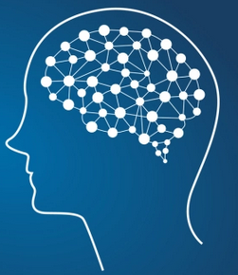
What is ML
Consider how we learn
A task, goal, question, or problem
Input: Experiences to learn from
Output:
A model making predictions
Answers
Good
enough?
Knowledge
Yes!
No!

Slide 9




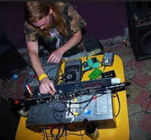

What is ML
Task: Figure out what songs you like so you keep coming back for more
What songs do you like?
Mogwai
The American
dollar
I love you but I have
chosen darkness
Sick Llama
Song | Like | Mellow rock | Instrumental arrangement | Minor key | Nu-disco qualities | Experi- mental noise | …
1 | Yes | 1 | 1 | 0 | 0 | 0 | …
2 | Yes | 0 | 1 | 1 | 0 | 0 | …
3 | Yes | 0 | 0 | 0 | 0 | 0 | …
4 | No | 1 | 1 | 1 | 1 | 1 | …
… | … | … | … | … |  | … | …
Instances
Labels
Features (1=True, 0=False)

Slide 10
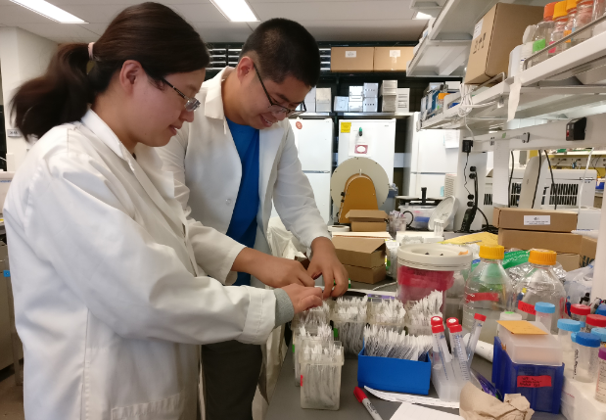
What is ML: from Spotify to Biology
Task: Figure out what songs you like so you keep coming back for more
Song | Like | Mellow rock | Instrumental arrangement | Minor key | Nu-disco qualities | …
1 | Yes | 1 | 1 | 0 | 0 | …
2 | Yes | 0 | 1 | 1 | 0 | …
3 | Yes | 0 | 0 | 0 | 0 | …
4 | No | 1 | 1 | 1 | 1 | …
… | … | … | … | … |  | …
Task: Figure out which genes belong to a particular pathway A
Gene | PWY A | Has domain X | Is expressed under Y | Interact with Z | Induced by W | …
1 | Yes | 1 | 1 | 0 | 0 | …
2 | Yes | 0 | 1 | 1 | 0 | …
3 | Yes | 0 | 0 | 0 | 0 | …
4 | No | 1 | 1 | 1 | 1 | …
… | … | … | … | … |  | …

Slide 11
What kinds of questions can be addressed
Semi-
supervised
learning
Unsupervised
Supervised: classification
Supervised:
regression
Reinforce-ment learning
Instances
Labels
Features
Instances
Labels
Gene | PWY A | Expr level | Has domain A
1 | YES | 90 | NO
2 | NO | 85 | NO
3 | YES | 80 | NO
4 | NO | 70 | YES
5 | NO | 65 | YES
6 | YES | 60 | NO
.. | .. | .. | ..
Gene | PWY A | Expr level | Has domain A
1 | YES | 90 | NO
2 | NO | 85 | NO
3 | YES | 80 | NO
4 | NO | 70 | YES
5 | NO | 65 | YES
6 | YES | 60 | NO
.. | .. | .. | ..
Gene | PWY A | Expr level | Has domain A
1 | YES | 90 | NO
2 | NO | 85 | NO
3 | YES | 80 | NO
4 | NO | 70 | YES
5 | NO | 65 | YES
6 | YES | 60 | NO
.. | .. | .. | ..
Task:
Find patterns
Task:
Predict a categorical label of an instance
Task:
Predict a numeric
label of an instance

Slide 12
What kinds of questions can be addressed
Poll
Which tasks involve supervised learning?
(1)
Netflix recommends a movie for customers
(2)
Distinguish pictures with dogs and no other animals
(3)
Use student data and sort them into groups
(4)
Put genes into groups based how they express
(5)
Use genetic information to predict plant height
Labels:
Different
customers
Labels:
Dog vs.
Other animals
Labels:
None
Labels:
None
Labels:
Heights
Notes:
Q. Which tasks involve supervised learning?

Slide 13
WHAT IS THE
WORKFLOW
IN A “TYPICAL” ML ANALYSIS?

Slide 14

How does ML work
What is the ML workflow?
ML
algorithms
Input: Experiences to learn from
Output:
answers, predictions
Answers
Good
enough?
No!
https://imgs.xkcd.com/comics/machine_learning.png

Slide 15


How does ML work
Five steps
Step 1:
Identifying problems
Step 2:
Data collection/
examination/
cleaning
Step 3:
Feature engineering
Step 4: Model/algorithm selection
Step 5:
Model application/
interpretation
Stomate
develop.
New data
X | ? | …
Y | ? | …
Protein
kinase
Interact
with Y
Gene X
Slow
evolving
Induced
by ABA
New data
X | 1 | …
Y | 0 | …
Datasets
WGD
duplicate
Expressed
In epidermis
What questions would you like to ask?
What data should you use & how to process it?
What features should be used & how should they
be generated?
Which algorithms
& hyper-
parameters to use?
How to evaluate & interpret the results?

Slide 16
Step 1:
WHAT IS YOUR
QUESTION?

Slide 17
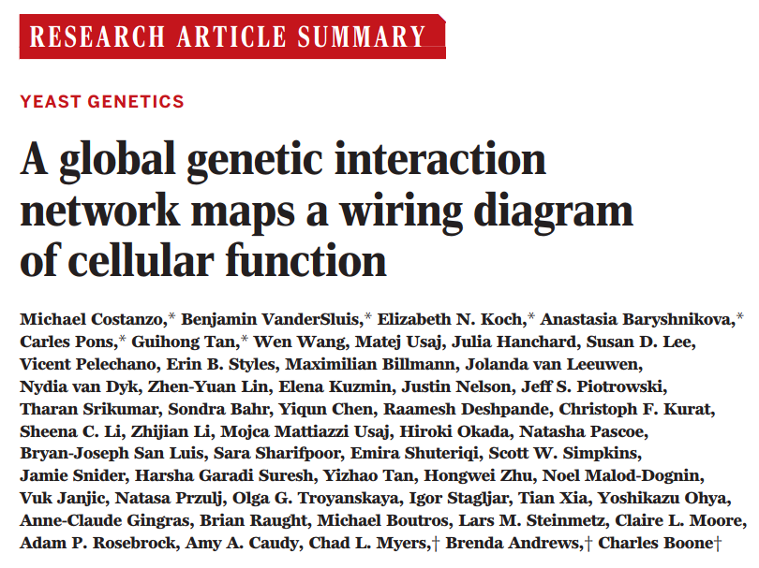
What is your question?
E.g., what kinds of genes when knock-out together have severe phenotype?
Science 2016 353:1381
Mutant g1 g2 g1/g2
1
0.8 0.7 0.6
Double not worse
than expected
Fitness
0
1
0.8 0.7 0.1
Double worse than
expected
Fitness
0
1
0.8 0.7 0.8
Double better than expected
Fitness
0

Slide 18
What is your question?
Poll
Biological question
Machine learning problem
What kinds of genes when knock-out together have higher fitness effects?
(1)
Unsupervised learning problem?
How well do clusters correspond to strong, weak, or no fitness effect gene pairs?
(2)
Classification problem?
How can we classify gene pairs into strong, weak, and no fitness effect classes?
Gene pairs | Genetic Interact score | Has function A | Has domain A
1 | -1.20 | YES | NO
2 | 0.05 | NO | NO
3 | 1.32 | YES | NO
4 | -0.01 | NO | YES
5 | -0.54 | NO | YES
6 | 0.02 | YES | NO
.. | .. | .. | ..
(3)
Regression
problem?
How can we predict the quantitative fitness effect of double mutants?
Notes:
This kind of biological question can be rephrased in which of the following machine learning problem statement(s)?

Slide 19
Step 2:
WHERE TO GET AND
HOW TO PROCESS
DATA?

Slide 20
Switching to Jupyter notebook
https://github.com/ShiuLab/ML_workshop/blob/master/ML_workshop_example_run.ipynb

Slide 21
Recap
Step 1:
Identifying problems
Step 2:
Data collection/
cleaning
Step 3:
Feature engineering
Step 4: Model/algorithm selection
Step 5:
Model application/
interpretation
New data
X | ? | …
Y | ? | …
Instances
Label
Features
Gene | Up-reg | Seq1 | Seq2 | …
A | 1 | 1 | 1 | …
B | 1 | 1 | 1 | …
C | 0 | 0 | 0 | …
D | 0 | 0 | 1 | …
… | … | … | … | …
New data
X | 1 | …
Y | 0 | …
Datasets
What questions would you like to ask?
What data should you use?
What features should be used?
Which algorithms and parameters to use?
How should we interpret the results?

Slide 22
Discussion
Reflection
(1 min)
Think about how you may answer this:
What topics in the workshop do you find unclear or difficult to understand?
Groups of 3-5
(4 min)
Share within your group
Do your group mates have solution?
What would you like to bring to the whole group for discussion?
Whole workshop
(5 min)
Report back via the chat function!
(If not enough time, we will save the questions and provide feedback in a document available from the ML_workshop Github page)

Slide 23
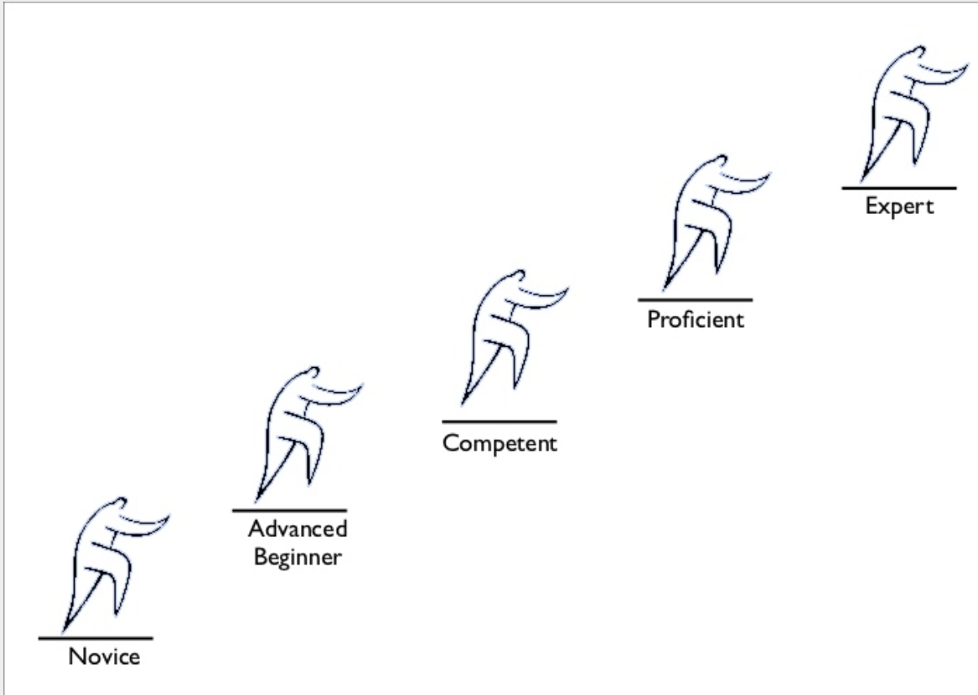
Building ML models
ML is a rather complicated tool…
It can be very useful
It is not magic
It can be over-hyped
Innovate
You can use it wrong
It evolves very fast
Implement established methods
Troubleshooting
Interpret results
It takes time to master
Understand
Collaborate

Slide 24

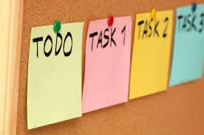
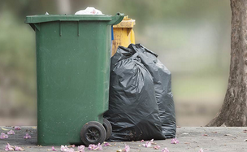

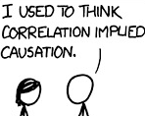
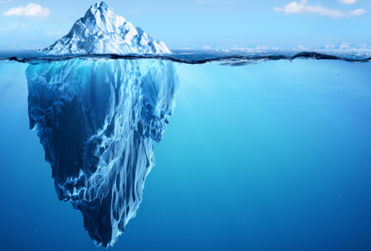
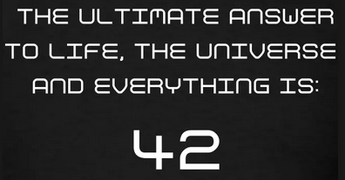
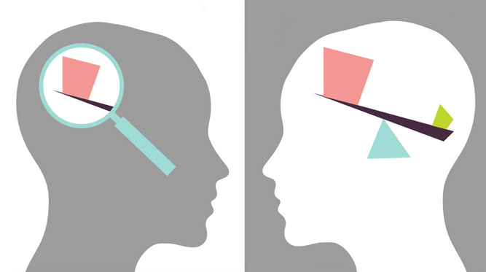
Limitations of ML
Specific model need for each task
High quality & quantity of data
“Here we see that models, despite their reputation for impartiality, reflect goals and ideology. When I removed the possibility of eating Pop-Tarts at every meal, I was imposing my ideology on the meals model. It’s something we do without a second thought. Our own values and desires influence our choices, from the data we choose to collect to the questions we ask. Models are opinions embedded in mathematics.”
Model reusability low
Supervised learning need labels
Pair | Fitness
G1-G2 | 0.9
G1-G3 | 0.1
…
Correlation NOT causation
Hidden variables
Model can be hard to
understand
Unknown bias in the data
Notes:
Image credit:
https://live.staticflickr.com/2615/4026814703_1e41b03876.jpg
https://upload.wikimedia.org/wikipedia/commons/a/af/Reduce_Reuse_Recycle.jpg
https://discover.rbcroyalbank.com/wp-content/uploads/banner-small-garbage-day_402x-1.jpg
http://intranetfactory.com/content2/image.axd?picture=2010%2F11%2Fistock_000011760242xsmall.jpg
https://image.spreadshirtmedia.com/image-server/v1/compositions/15153709/views/1,width=650,height=650,appearanceId=2,version=1547213188/hitchhikers-guide-42-t-shirt-all-our-hitchhikers-guide-products-are-unique-works-of-art-not-available-commercially-international-shipping-availabl.jpg
https://cdn.iconscout.com/icon/free/png-256/discount-ribbon-tag-label-sale-shop-shopping-1-24561.png
https://cdn.searchenginejournal.com/wp-content/uploads/2017/09/Untitled-design-10-760x400.png
https://www.vision.org/sites/default/files/img/2015fall_checking-the-bias_1920x1080.jpg

Slide 25

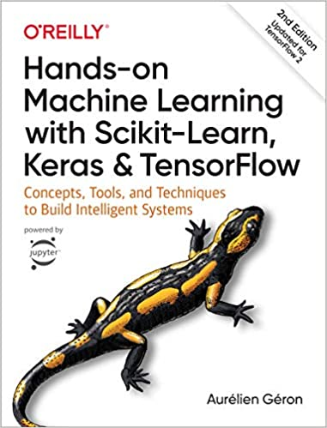
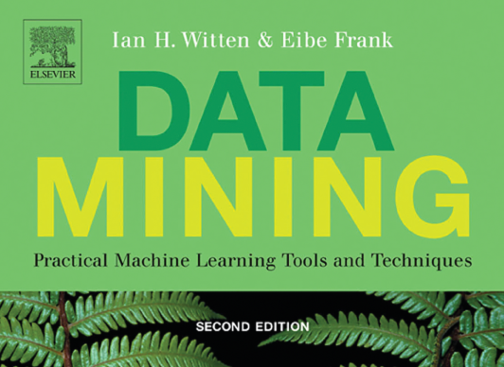
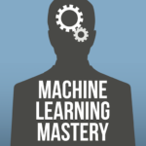
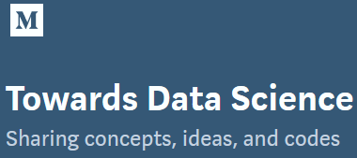
Resources
This workshop
https://github.com/ShiuLab/ML_workshop
Online course
Blog

Slide 26
Thanks for coming…
Before we break, any question?

Slide 27
SPARE SLIDES

Slide 28

Why ML
As a person
Image credits: in notes
Notes:
Image credits:
https://cdn.technologyreview.com/i/images/waymovehicle1.jpg?sw=959&cx=0&cy=466&cw=3000&ch=1687
https://compostables.org/wp-content/uploads/2018/09/All-new-Echo-Dot-3rd-Gen-Smart-speaker-with-Alexa-Sandstone-0.jpg
https://amp.businessinsider.com/images/5c6d85ca2628986f7f3a5d02-750-563.jpg
https://static.boredpanda.com/blog/wp-content/uploads/2015/08/computer-deep-learning-algorithm-painting-masters-fb__700.jpg
https://media.salon.com/2019/01/facial-recognition2.jpg
https://www.greenmangaming.com/newsroom/wp-content/uploads/2019/07/GooglrDeepMind.jpg

Slide 29
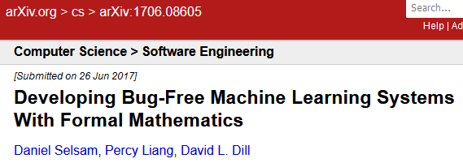
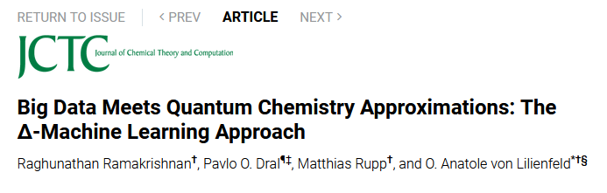
Why ML
As a person
As a scientist
Image credits: in notes
Notes:
Image credits:
https://cdn.technologyreview.com/i/images/waymovehicle1.jpg?sw=959&cx=0&cy=466&cw=3000&ch=1687
https://compostables.org/wp-content/uploads/2018/09/All-new-Echo-Dot-3rd-Gen-Smart-speaker-with-Alexa-Sandstone-0.jpg
https://amp.businessinsider.com/images/5c6d85ca2628986f7f3a5d02-750-563.jpg
https://static.boredpanda.com/blog/wp-content/uploads/2015/08/computer-deep-learning-algorithm-painting-masters-fb__700.jpg
https://media.salon.com/2019/01/facial-recognition2.jpg
https://www.greenmangaming.com/newsroom/wp-content/uploads/2019/07/GooglrDeepMind.jpg

Slide 30
Why ML
ML publications in PubMed as of 7/22/20
As a person
As a scientist
Genetics
Trans-
criptome
Machine
learning
As a biologist
Image credits: in notes
Notes:
Image credits:
https://cdn.technologyreview.com/i/images/waymovehicle1.jpg?sw=959&cx=0&cy=466&cw=3000&ch=1687
https://compostables.org/wp-content/uploads/2018/09/All-new-Echo-Dot-3rd-Gen-Smart-speaker-with-Alexa-Sandstone-0.jpg
https://amp.businessinsider.com/images/5c6d85ca2628986f7f3a5d02-750-563.jpg
https://static.boredpanda.com/blog/wp-content/uploads/2015/08/computer-deep-learning-algorithm-painting-masters-fb__700.jpg
https://media.salon.com/2019/01/facial-recognition2.jpg
https://www.greenmangaming.com/newsroom/wp-content/uploads/2019/07/GooglrDeepMind.jpg

Slide 31
Why ML
ML publications in PubMed as of 7/22/20
As a person
As a scientist
As a biologist
As a plant biologist
Machine learning
Others
(32,976)
Human
(43,288)
Others
(15,626)
Human
(18,668)
Transcriptome
Plant (20,441)
Plant (1,027)
Image credits: in notes
Notes:
Image credits:
https://cdn.technologyreview.com/i/images/waymovehicle1.jpg?sw=959&cx=0&cy=466&cw=3000&ch=1687
https://compostables.org/wp-content/uploads/2018/09/All-new-Echo-Dot-3rd-Gen-Smart-speaker-with-Alexa-Sandstone-0.jpg
https://amp.businessinsider.com/images/5c6d85ca2628986f7f3a5d02-750-563.jpg
https://static.boredpanda.com/blog/wp-content/uploads/2015/08/computer-deep-learning-algorithm-painting-masters-fb__700.jpg
https://media.salon.com/2019/01/facial-recognition2.jpg
https://www.greenmangaming.com/newsroom/wp-content/uploads/2019/07/GooglrDeepMind.jpg

Slide 32
Goals of this workshop
At the end of this, you should be able to:
Define ML and basic ML terminology
Identify what kinds of problems that can be solved with ML
Explain how an example ML algorithm works
Describe how a model can be evaluated with a performance measure
Design an overall ML workflow for your own question
Explain to others what the major limitations of ML are

Slide 33
Step 1: Identifying problems
Turn a biological question into a machine learning one
Unsupervised
Regression
Classification
Labels
Labels
Gene pairs | Double mutant fitness | Has function X | Has domain A
1 | -1.20 | YES | NO
2 | 0.05 | NO | NO
3 | 1.32 | YES | NO
4 | -0.01 | NO | YES
5 | -0.54 | NO | YES
6 | 0.02 | YES | NO
.. | .. | .. | ..
Gene | Double mutant fitness | Has function X | Has domain A
1 | -1.20 | YES | NO
2 | 0.05 | NO | NO
3 | 1.32 | YES | NO
4 | -0.01 | NO | YES
5 | -0.54 | NO | YES
6 | 0.02 | YES | NO
.. | .. | .. | ..
Gene | Double mutant fitness | Has function X | Has domain A
1 | -1.20 | YES | NO
2 | 0.05 | NO | NO
3 | 1.32 | YES | NO
4 | -0.01 | NO | YES
5 | -0.54 | NO | YES
6 | 0.02 | YES | NO
.. | .. | .. | ..
Task:
Find patterns in the dataset
Task:
Predict numeric values
based on other info
Task:
Predict categorical values based on other info

Slide 34

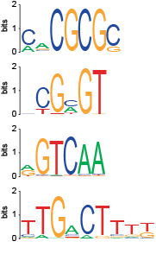
What kinds of questions: example 1
Three examples
Task: Predict which gene is responsive to high salinity stress
Ikke bry meg!
لا يزعجني
邪魔しないで!
Leave me alone!
Pla my nie!
ไม่รำคาญครับ
עזוב אותי
Instances
Labels
Features
Gene | Response | Motif 1 | Motif 2 | ..
1 | Yes | 0 | 1 | ..
2 | No | 1 | 0 | ..
3 | Yes | 0 | 1 | ..
4 | Yes | 1 | 1 | ..
5 | No | 0 | 0 | ..
6 | No | 1 | 0 | ..
.. | .. | .. | .. | ..
別煩我!
मुझे परेशान नहीं करते!
չեն անհանգստացնել ինձ!
Presence
absence
Location
ML algorithms
Responsive
to stress
X
Copy
number
Combina-
tion
Zou et al. (2011) PNAS

Slide 35
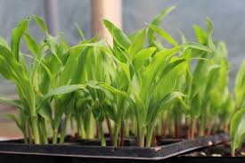
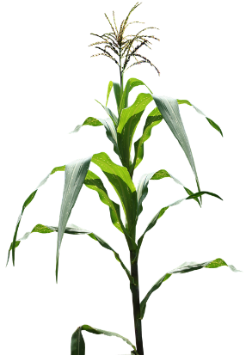
What kinds of questions: example 2
Task: Predict flowering time based on transcriptome variation
Genotype data:
Hirsch et al. (2014) Plant Cell,
genetic markers
Three examples
Question 1:
Are transcriptomes useful for predicting traits, even if the developmental stages differ?
Instances
Labels
Features
Plant | Flowering time | Trans-cript 1 | Trans-cript 2 | ..
1 | 189 | 10 | 6 | ..
2 | 156 | 1024 | 11 | ..
3 | 176 | 23 | 2 | ..
4 | 90 | 56 | 0 | ..
5 | 165 | 865 | 10 | ..
6 | 159 | 1 | 0 | ..
.. | .. | .. | .. | ..
Transcriptomes:
Hirsch et al. (2014) Plant Cell,
Seedling
Question 2:
Do transcriptomes provide different information from genotype data?
Phenotype data:
Flowering time, height, yield
“Adult” plants
Azodi et al. bioRxiv
E-poster: 0300-165
Notes:
Image credit:
https://cdn.pixabay.com/photo/2015/10/22/12/32/maize-field-1001106_960_720.png

Slide 36
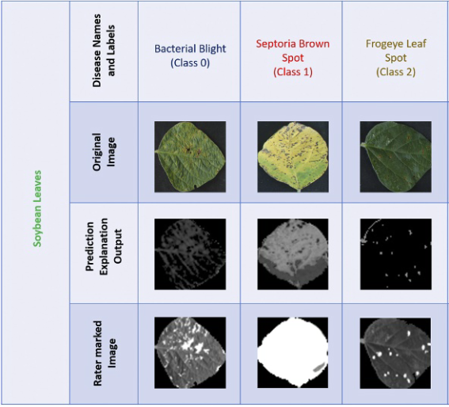
What kinds of questions: example 3
Task: Predict disease based on images
Three examples
Bacterial
blight
(class 1)
Septoria
brown
spot
(class 2)
Forage
leaf
spot
(class 3)
Soybean
leaves
Instances
Labels
Features
Image | Disease
1 | Fungal
2 | Bacterial
3 | Insect
4 | Nutrient
5 | Insect
6 | Bacterial
.. | .. | .. | .. | ..
Original
image
Explanation
output from
predictions
Features are not defined before-hand, but learned by computer!!
Rater
marked
images
Ghosal et al. (2018) PNAS

Slide 37
Step 2 Data collection/cleaning
Step 1:
Identifying problems
Step 2:
Data collection/
cleaning
Step 3:
Feature engineering
Step 4: Model/algorithm selection
Step 5:
Model application/
interpretation
New data
X | ? | …
Y | ? | …
Instances
Label
Features
Gene | Up-reg | Seq1 | Seq2 | …
A | 1 | 1 | 1 | …
B | 1 | 1 | 1 | …
C | 0 | 0 | 0 | …
D | 0 | 0 | 1 | …
… | … | … | … | …
New data
X | 1 | …
Y | 0 | …
Datasets
What questions would you like to ask?
What data should you use?
What features should be used?
Which algorithms and parameters to use?
How should we interpret the results?

Slide 38
Step 2: Data collection/processing
Where do the data come from?
Which dataset should we use?
Molecular data
Evolutionary/
ecological data
Task: What kinds of genes tend to have positive or negative genetic interactions?
Genomes
Metabolomes
Physiological
measurements
Transcriptomes
Morphological
measurements
Use data based on what we already know
Use EVERYTHING!
Proteomes
Methylome
Environmental
Microbiomes
Interactomes
And more…
And more…

Slide 39
Step 2: Data collection/processing
Split data into training and testing sets
Training
Output:
ML
model
Training
data
80%
Input:
all instances
all features
Testing
data
Application
Model
Perform-
ance
20%

Slide 40

Step 2: Data collection/processing
Poll
How many problems can you find in the dataset?
Format
Instances
Labels
Features
Data quality
Gene pairs | Genet Interact | Expr cor. 1 | Expr cor. 2 | Physical Interact | Double mutant pheno.
G1-G2 | 0.002 | 90 | 10 | NO | Severe
G1-G3 | 0.1 | ? | ? | NO | ?
G1-G4 | - | 20 | 18 | ? | NO
G1-G5 | 0.2 | 1234201 | 2945 | YES | NO
G2-G3 | 0.01 | 15 | 189 | Y | Sevvere
G1-G2 | -0.3 | 90 | 10 | NO | Mild
G2-G5 | Unsure | 240 | 30 | NO | Mild
.. | .. | .. | .. | .. | ..
Missing data
Typo
Duplicate
Irrelevant to the task
Inconsistent value format
Outlier
Notes:
How many problem(s) can you find in this dataset??
1, 3, 5, 7, 9
More information:
https://elitedatascience.com/data-cleaning
https://towardsdatascience.com/the-art-of-cleaning-your-data-b713dbd49726

Slide 41
Step 3 Feature engineering
Step 1:
Identifying problems
Step 2:
Data collection/
cleaning
Step 3:
Feature engineering
Step 4: Model/algorithm selection
Step 5:
Model application/
interpretation
New data
X | ? | …
Y | ? | …
Instances
Label
Features
Gene | Up-reg | Seq1 | Seq2 | …
A | 1 | 1 | 1 | …
B | 1 | 1 | 1 | …
C | 0 | 0 | 0 | …
D | 0 | 0 | 1 | …
… | … | … | … | …
New data
X | 1 | …
Y | 0 | …
Datasets
What questions would you like to ask?
What data should you use?
What features should be used?
Which algorithms and parameters to use?
How should we interpret the results?

Slide 42
Step 2: Data collection /processing
Value scaling (continuous) and encoding (discrete)
Instances
Labels
Features
Instances
Labels
Features
Gene pairs | Genet Interact | Expr cor. | Physical Interact | Double mutant pheno.
G1-G2 | 0.002 | 10 | NO | Severe
G1-G3 | 0.1 | 20 | NO | Mild
G1-G4 | -0.05 | 18 | YES | NO
G1-G5 | 0.2 | 2945 | YES | NO
G2-G3 | 0.01 | 189 | YES | Severe
G1-G2 | -0.3 | 10 | NO | Mild
.. | .. | .. | .. | ..
Gene pairs | Genet Interact | Expr cor. | Physical Interact | Double severe | Double mild
G1-G2 | 0.002 | -0.44 | 0 | 1 | 0
G1-G3 | 0.1 | -0.43 | 0 | 0 | 1
G1-G4 | -0.05 | -0.43 | 1 | 0 | 0
G1-G5 | 0.2 | 2.04 | 1 | 0 | 0
G2-G3 | 0.01 | -0.29 | 1 | 1 | 0
G1-G2 | -0.3 | -0.44 | 0 | 0 | 1
.. | .. | .. | .. | .. | …
Standard scaling
Binari-zation
One-hot
encoding
Notes:
How many problem(s) can you find in this dataset??
1, 3, 5, 7, 9
More information:
https://elitedatascience.com/data-cleaning
https://towardsdatascience.com/the-art-of-cleaning-your-data-b713dbd49726

Slide 43
Step 3:
WHICH
FEATURES
YOU SHOULD USE AND IN WHAT
FORM
?

Slide 44
Step 3: Feature engineering
Identify features relevant to the underlying tasks
Feature
engineering
Training
data
Output:
ML
model
80%
Input:
all instances
all features
Training
Testing
data
Application
Model
Perform-
ance
20%

Slide 45
Step 3: Feature engineering
Recall…
What features should be included?
Instances
Labels
Features
E.g. transcriptome
Expert knowledge/
literature
Exp1
Gene Pair | Genet interact | Feat 1 | Feat 2 | Feat 3
Exp1
Exp1
Exp1
Exp1
Trans-
formation
Exp1
Exp X
“Raw”
features
“Derived”
features
 | Expression levels
Gene | Exp A | Exp B | Exp C | ..
1
2
3
4
..
 | Log10(expr level)
Gene | Exp A | Exp B | Exp C | ..
1
2
3
4
..
 | Expr correlation
Gene | 1 | 2 | 3 | ..
1
2
3
4
..
Task: Learn a model using features to predict double
mutant fitness

Slide 46
Step 3: Feature engineering
Ok, we have tones of features, should we just use all of them?
Why?
How to select features?
Those with strongest relationships with the labels
 | With domain 1 | Without domain 1
In PWY A | 100 | 0
Not in PWY A | 0 | 30,000
NO!
Most features are not relevant
Some features are redundant
Making prediction with noise
Those with “high importance” in the model
Generated by most ML algorithms
More features
More compli-cated models
Harder to figure out how it works
https://machinelearningmastery.com/an-introduction-to-feature-selection/

Slide 47
Step 3: Feature engineering
Process of feature engineering
Training
data
Fit
Inter-
mediate
model
Measures of
feature
importance
Output:
FINAL
model
Transform
Modified
Training
data

Slide 48
Step 4 Model/algorithm selection
Step 1:
Identifying problems
Step 2:
Data collection/
cleaning
Step 3:
Feature engineering
Step 4: Model/algorithm selection
Step 5:
Model application/
interpretation
New data
X | ? | …
Y | ? | …
Instances
Label
Features
Gene | Up-reg | Seq1 | Seq2 | …
A | 1 | 1 | 1 | …
B | 1 | 1 | 1 | …
C | 0 | 0 | 0 | …
D | 0 | 0 | 1 | …
… | … | … | … | …
New data
X | 1 | …
Y | 0 | …
Datasets
What questions would you like to ask?
What data should you use?
What features should be used?
Which algorithms and parameters to use?
How should we interpret the results?

Slide 49
Step 4:
WHICH
ALGORITHMs/
PARAMETERS
TO USE
?

Slide 50
Step 4: Model/algorithm selection
Choosing among candidate models
Model
selection
Training
data
Output:
ML
model
80%
Input:
all instances
all features
Training
Testing
data
Application
Model
Perform-
ance
20%

Slide 51

Why would there be many models?
Reason 1: There are a lot of algorithms.

Slide 52
Step 4: Model/algorithm selection
How the algorithm work
Decision tree
A genes:5
Non-A genes: 5
Gene | PWY A | Control shoot transcript level | Herbivory root transcript level
1 | YES | 0 | 391
2 | YES | 24 | 111
3 | YES | 40 | 163
4 | YES | 100 | 350
5 | YES | 45 | 23
6 | NO | 290 | 200
7 | NO | 124 | 220
8 | NO | 235 | 120
9 | NO | 7 | 250
10 | NO | 352 | 261
Control shoot
transcript Level
≥102
<102
A genes:0
Non-A genes: 4
A genes:5
Non-A genes: 1
Herbivory root
transcript Level
≥300
<300
Linear
decision boundary
Support vector machine
Non-linear decision boundary
A genes:1
Non-A genes: 0
A genes:3
Non-A genes: 1

Slide 53
Step 4: Model/algorithm selection
Each algorithm has its own hyperparameters
You need to find out which parameters are the best…
Instead of these exact numbers, we will pick them randomly.
RandomForestRegressor
n_estimators, default=100
max_depth, default=None
min_samples_split, default=2
min_samples_leaf, default=1
max_features, default=”auto”
…
(many more)
Say we try:
n_estimator = [10, 50, 100, 200, 500]
max_depth = [2, 4, 5]
min_samples_split = [2, 4, 8]
min_samples_leaf = [1, 2, 3]
max_features = [‘auto’, ‘sqrt’, ‘log2’]
Then we would run the regressor:
5 x 3 x 3 x 3 x 3 = 405 times

Slide 54

Step 4: Model/algorithm selection
And you don’t just run this once!
Cross validation
1
2
3
4
5
6
7
8
9
10
Cross-validation folds
Split
training
data
Model
Input:
training
instances
Training
Set
(90%)
Validation
Set
(10%)
Average model performance
Performance

Slide 55
Step 4b: Model evaluation
Pathway A |  | Truth
 |  | Is | Is not
Prediction | Is | 5 | 1 | 83%
 | Is not | 0 | 4 | 100%
 |  | 100% | 80%
Real
data
Random
data
Perfect
data
Model eval
Gene | PWY A | Control shoot transcript level
1 | YES | 0
2 | YES | 24
3 | YES | 40
4 | YES | 100
5 | YES | 45
6 | NO | 290
7 | NO | 124
8 | NO | 235
9 | NO | 7
10 | NO | 400
400
10
10
10
True positive rate
True negative rate
6
3
6
8
Not
A
8
8
7
7
7
4
4
9
Is A
5
5
5
True positive rate
3
6
3
2
2
2
Model: Control shoot transcript level is predictive of PWY A membership
9
9
4
0
1
1
1
False negative rate (1 - True negative rate)

Slide 56
Step 5 Model application/interpretation
Step 1:
Identifying problems
Step 2:
Data collection/
cleaning
Step 3:
Feature engineering
Step 4: Model/algorithm selection
Step 5:
Model application/
interpretation
New data
X | ? | …
Y | ? | …
Instances
Label
Features
Gene | Up-reg | Seq1 | Seq2 | …
A | 1 | 1 | 1 | …
B | 1 | 1 | 1 | …
C | 0 | 0 | 0 | …
D | 0 | 0 | 1 | …
… | … | … | … | …
New data
X | 1 | …
Y | 0 | …
Datasets
What questions would you like to ask?
What data should you use?
What features should be used?
Which algorithms and parameters to use?
How should we interpret the results?

Slide 57
Step 5:
HOW TO APPLY MODELS TO
NEW CASES AND
MAKE SENSE OF THE PREDICTIONS
?

Slide 58
Step 5: Model application/interpretation
Evaluate how well the model work with the independent, testing data
Training
Output:
ML
model
Training
data
80%
Input:
all instances
all features
Application
Testing
data
Model
Perform-
ance
20%
Application
New
data
Predictions

Slide 59
Discussion 2
Reflection
(2 min)
Think about how you may answer this:
What do you perceive as the challenges for you to adopt ML?
Groups of 3-5
(8 min)
Share within your group
The challenges you face.
What resources will be useful for you to meet the challenges?
Whole workshop
(10 min)
Report back!

Slide 60
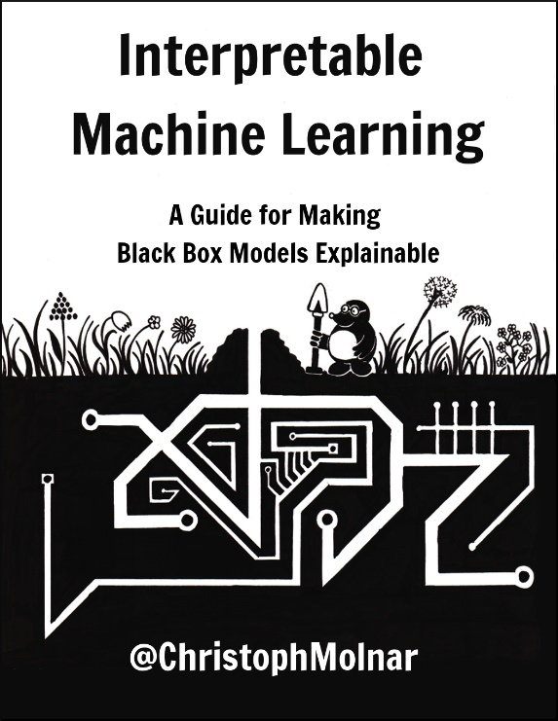
Step 5: model application/interpretation
Interpretation
Decision tree
A genes:5
Non-A genes: 5
If control shoot ≥102:
then not A
else:
if herbivory root ≥300:
then A
else:
75% chance A
Umm…. What??
Control shoot
transcript Level
≥102
<102
A genes:0
Non-A genes: 4
A genes:5
Non-A genes: 1
Herbivory root
transcript Level
≥300
<300
Decision boundary
Support vector machine
Non-linear decision boundary
A genes:1
Non-A genes: 0
A genes:3
Non-A genes: 1

Slide 61
Spare

Slide 62
Step 3.5: Splitting data into training and testing
Pathway A |  | Truth
 |  | Is | Is not
Prediction | Is | 45 | 10 | 82%
 | Is not | 5 | 40 | 89%
 |  | 90% | 80%
Start over…
Feature
selection
algorithms
ML
algorithms
Input:
training
instances
Selected
features
Output:
ML
model
Model
Performance
Based on
training
instances
Answers
Good
enough?
Input:
training
instances
all features
90%
Input:
all instances
all features
No!
Yes!
Input:
testing
instances
all features
Input:
training
instances
Selected
features
10%
Input:
New instances
Predictions
New
instances
Pathway A |  | Truth
 |  | Is | Is not
Prediction | Is | 35 | 17 | 67%
 | Is not | 15 | 33 | 69%
 |  | 70% | 66%
Model
Performance
Based on
testing
instances

Slide 63
Step 3.5: Splitting data into training and testing
Is the
model
really
that good?
Why…
Task:
Predict genes in pathway A
Pathway A |  | Truth
 |  | Is | Is not
Prediction | Is | 25 | 25 | 50%
 | Is not | 25 | 25 | 50%
 |  | 50% | 50%
Pathway A |  | Truth
 |  | Is | Is not
Prediction | Is | 40 | 20 | 67%
 | Is not | 10 | 30 | 75%
 |  | 80% | 60%
Pathway A |  | Truth
 |  | Is | Is not
Prediction | Is | 45 | 10 | 82%
 | Is not | 5 | 40 | 89%
 |  | 90% | 80%
Knowing (truth):
50 genes in X
50 genes not in X
Feature
selection
algorithms
ML
algorithms
Answers
Good
enough?
Input:
all instances
all features
Input:
all instances
selected
features
Output:
ML
model
Model performance
based on
all instances
Yes!
Input:
New instances
Predictions
New
instances
No!
How do you
know that the
model works?
True positive rate
Positive predictive value
True negative rate
Negative predictive value

Slide 64
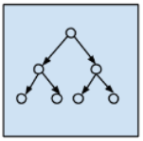
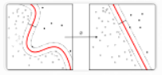
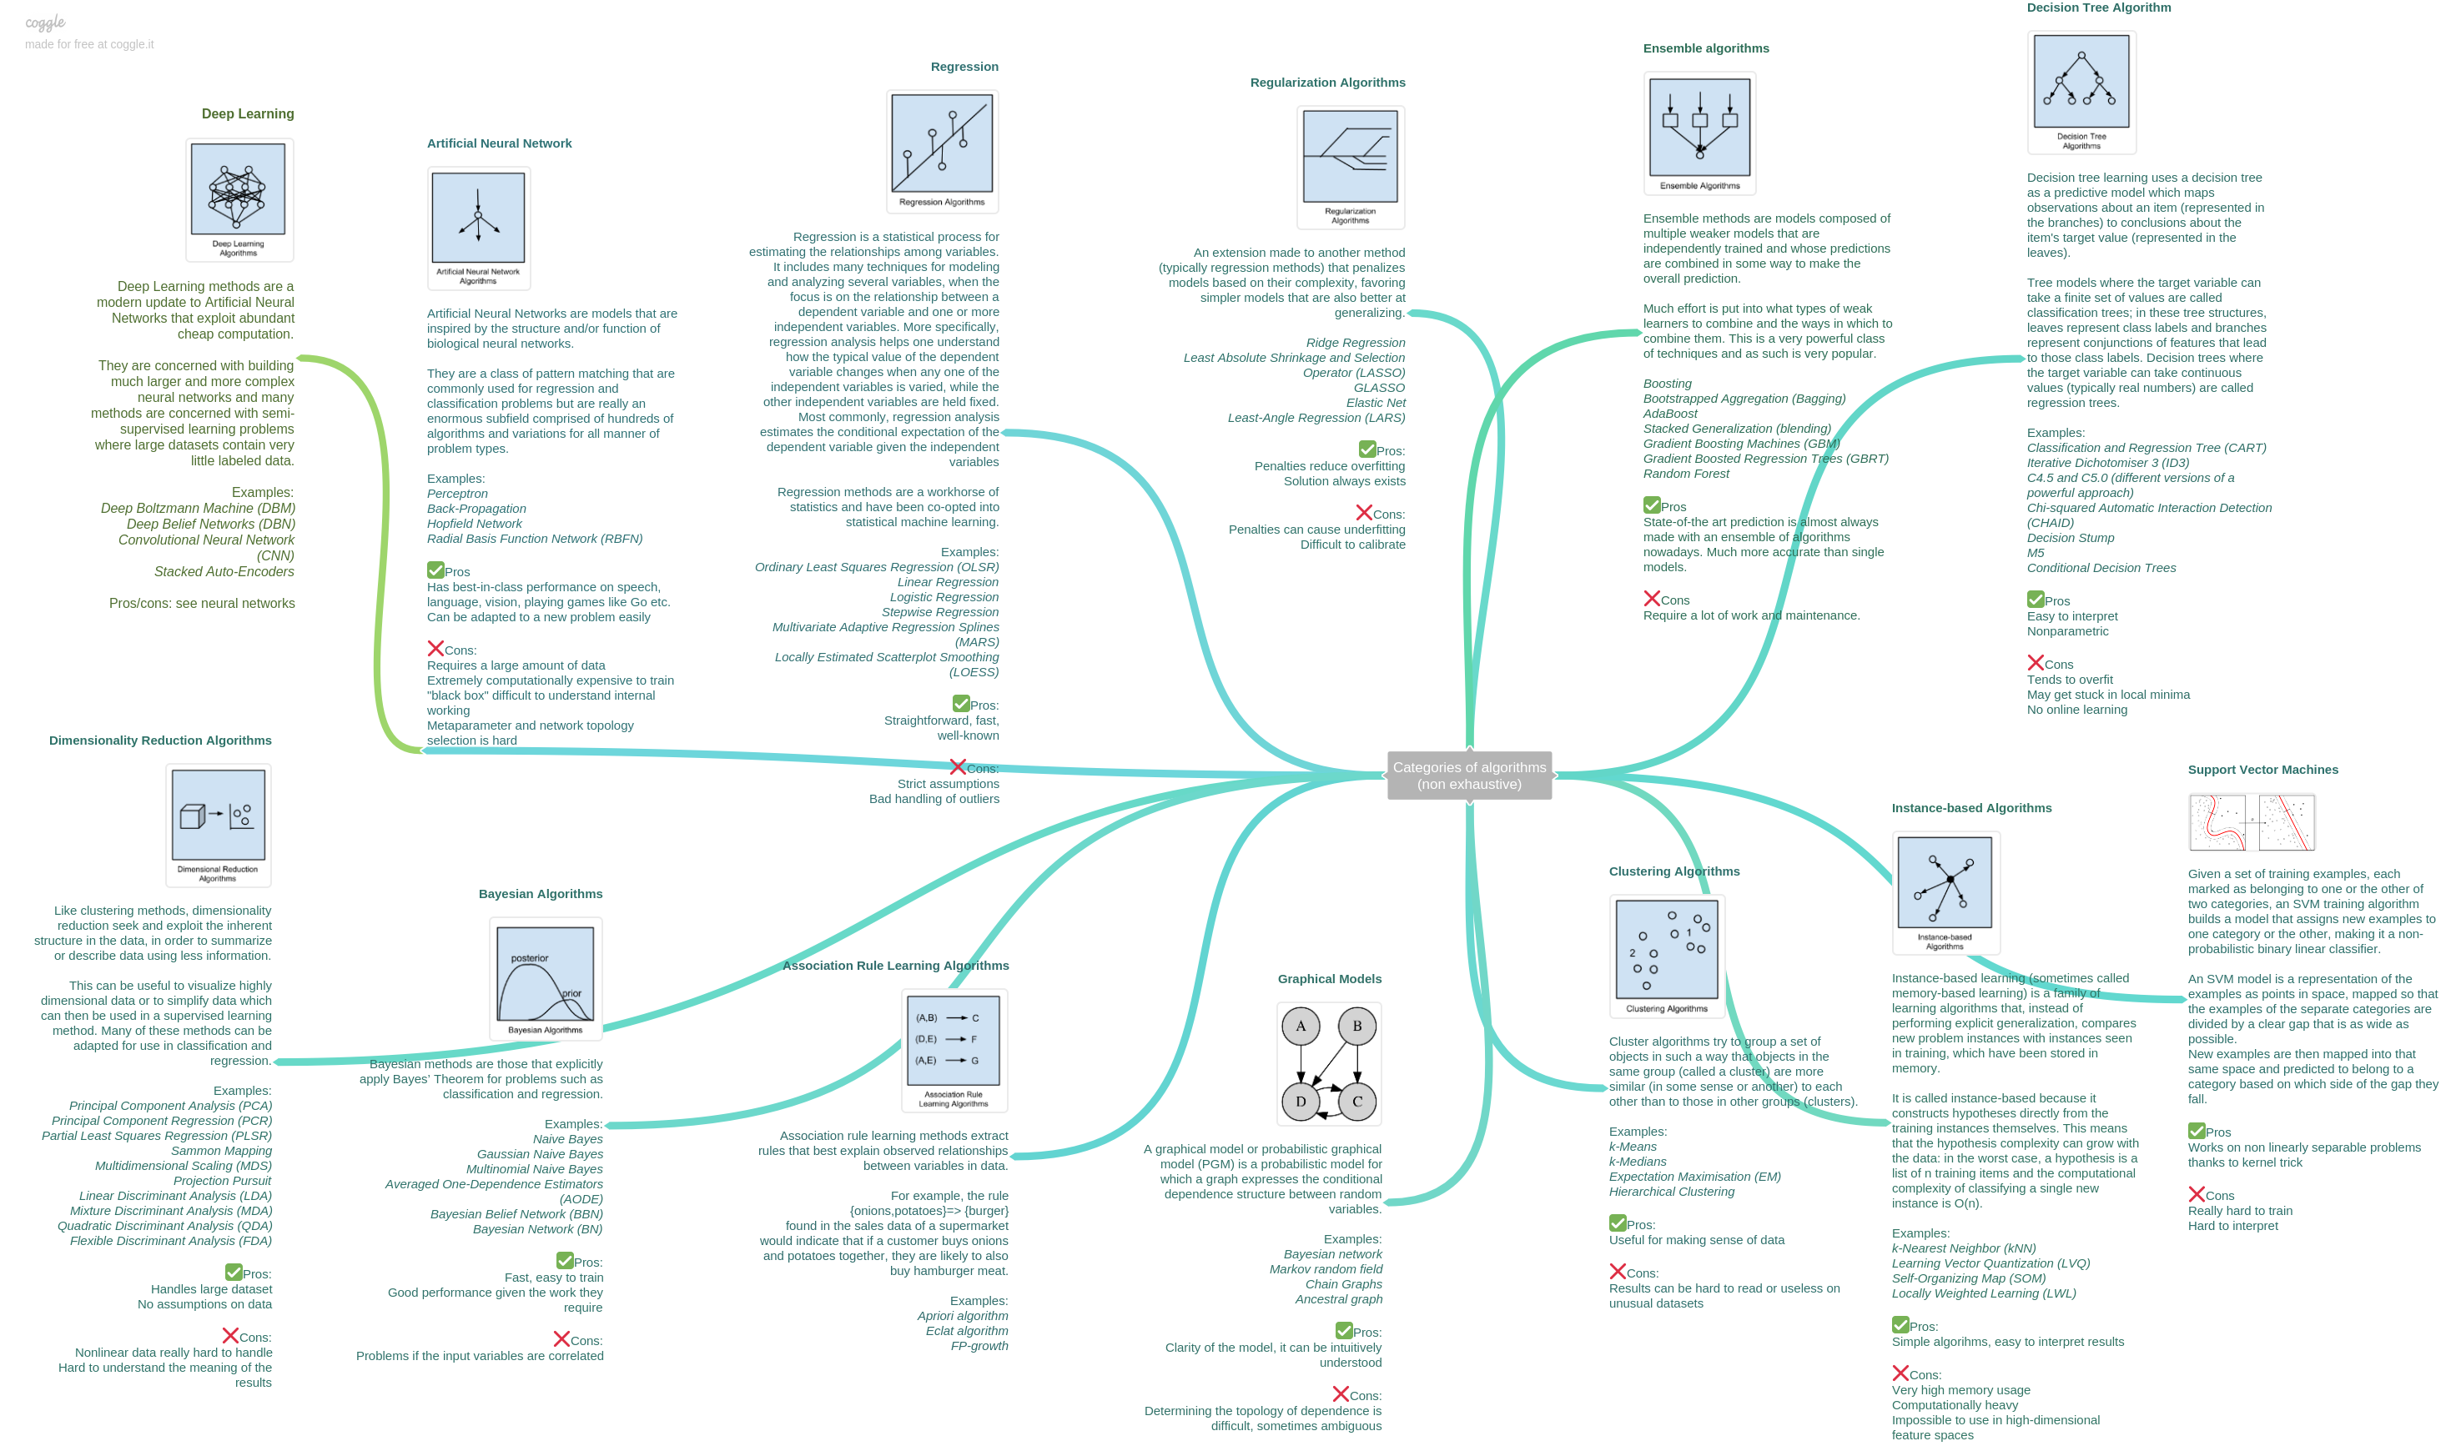
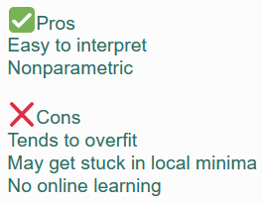
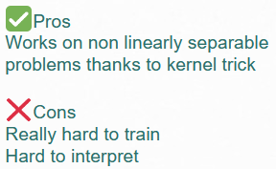
Step 4: Model/algorithm selection
ML
algorithms
Which algorithms should we use?
Input
data
ML
model
https://static.coggle.it/diagram/WHeBqDIrJRk-kDDY/t/categories-of-algorithms-non-exhaustive

Slide 65
What kinds of questions can be addressed
Supervised learning
Unsupervised learning
Instances
Labels
Features
Instances
Features
Gene | PWY A | Expr level | Has domain A | Dev. Defect
1 | YES | 90 | NO | Severe
2 | NO | 85 | NO | Mild
3 | YES | 80 | NO | NO
4 | NO | 70 | YES | NO
5 | NO | 65 | YES | Severe
6 | YES | 60 | NO | Mild
.. | .. | .. | .. | ..
Gene | PWY A | Expr level | Has domain A | Dev. Defect
1 | YES | 90 | NO | Severe
2 | NO | 85 | NO | Mild
3 | YES | 80 | NO | NO
4 | NO | 70 | YES | NO
5 | NO | 65 | YES | Severe
6 | YES | 60 | NO | Mild
.. | .. | .. | .. | ..
Task: Learn which gene may belong to pathway A
Task: Learn some unspecified patterns from the data

Slide 66
How does ML work
Five steps
Step 1:
Identifying problems
Step 2:
Data collection/
cleaning
Step 3:
Feature engineering
Step 4: Model/algorithm selection
Step 5:
Model application/
interpretation
New data
X | ? | …
Y | ? | …
Instances
Label
Features
Gene | Up-reg | Seq1 | Seq2 | …
A | 1 | 1 | 1 | …
B | 1 | 1 | 1 | …
C | 0 | 0 | 0 | …
D | 0 | 0 | 1 | …
… | … | … | … | …
New data
X | 1 | …
Y | 0 | …
Datasets
What questions would you like to ask?
What data should you use?
What features should be used?
Which algorithms and parameters to use?
How should we interpret the results?

Slide 67
What kinds of questions can be addressed
Classification
Regression
Instances
Labels
Instances
Labels
Gene | PWY A | Expr level | Has domain A | Dev. Defect
1 | YES | 90 | NO | Severe
2 | NO | 85 | NO | Mild
3 | YES | 80 | NO | NO
4 | NO | 70 | YES | NO
5 | NO | 65 | YES | Severe
6 | YES | 60 | NO | Mild
.. | .. | .. | .. | ..
Gene | PWY A | Expr level | Has domain A | Dev. Defect
1 | YES | 90 | NO | Severe
2 | NO | 85 | NO | Mild
3 | YES | 80 | NO | NO
4 | NO | 70 | YES | NO
5 | NO | 65 | YES | Severe
6 | YES | 60 | NO | Mild
.. | .. | .. | .. | ..
Task: Learn if a gene belong to PWY A
Task: Learn how to predict expression level

Slide 68
Step 4: Model/algorithm selection
Feature
selection
algorithms
ML
algorithms
Input:
training
instances
all features
Input:
training
instances
Selected
features
Output:
ML
model
Performance
Based on
training
instances
80%
Input:
all instances
all features
Input:
testing
instances
all features
20%
Task:
Predict genes in pathway A
Pathway A |  | Truth
 |  | Is | Is not
Prediction | Is | 25 | 25 | 50%
 | Is not | 25 | 25 | 50%
 |  | 50% | 50%
Pathway A |  | Truth
 |  | Is | Is not
Prediction | Is | 45 | 10 | 82%
 | Is not | 5 | 40 | 89%
 |  | 90% | 80%
Knowing (truth):
50 genes in A
50 genes not in A

Slide 69
Step 4b: Model evaluation
Pathway A |  | Truth
 |  | Is | Is not
Prediction | Is | 45 | 10 | 82%
 | Is not | 5 | 40 | 89%
 |  | 90% | 80%
With the independent testing set
Feature
selection
ML
algorithms
Input:
training
instances
all features
Input:
training
instances
Selected
features
Output:
ML
model
Model
Performance
Based on
training
instances
90%
Input:
all instances
all features
FINAL
MODEL
Input:
testing
instances
all features
Input:
testing
instances
Selected
features
10%
Pathway A |  | Truth
 |  | Is | Is not
Prediction | Is | 35 | 17 | 67%
 | Is not | 15 | 33 | 69%
 |  | 70% | 66%
Model
Performance
Based on
testing
instances

Slide 70
Step 5: Model application/interpretation
Application on new instances
Feature
selection
ML
algorithms
Input:
training
instances
all features
Input:
training
instances
Selected
features
Output:
ML
model
Model
Performance
Based on
training
instances
90%
Input:
all instances
all features
FINAL
MODEL
Input:
testing
instances
all features
Input:
training
instances
Selected
features
10%
Gene | PWY A | Control shoot transcript level | Herbivory root transcript level
W | ? | 30 | 101
X | ? | 65 | 123
Y | ? | 311 | 249
Z | ? | 127 | 250
Model
Performance
Based on
testing
instances
YES
YES
NO
NO
New
data

Slide 71
What kinds of questions can be addressed
Supervised learning
Unsupervised learning
Instances
Labels
Features
Instances
Variables
Gene | PWY A | Expr level | Has domain A | Dev. Defect
1 | YES | 90 | NO | Severe
2 | NO | 85 | NO | Mild
3 | YES | 80 | NO | NO
4 | NO | 70 | YES | NO
5 | NO | 65 | YES | Severe
6 | YES | 60 | NO | Mild
.. | .. | .. | .. | ..
Gene | Expr level | Has domain A | Dev. Defect
1 | 90 | NO | Severe
2 | 85 | NO | Mild
3 | 80 | NO | NO
4 | 70 | YES | NO
5 | 65 | YES | Severe
6 | 60 | NO | Mild
.. | .. | .. | ..
Semi-
supervised
learning
Reinforce-ment learning
Task: Learn which gene may belong to pathway A
Task: Learn some unspecified patterns from the data

Slide 72
Summary
Recall our goals
Define ML and basic ML terminology
Identify what kinds of problems that can be solved with ML
Describe how a model can be evaluated with a performance measure
Explain to others what the major limitations of ML are

